Slide 1
COMMISSIONER CABINET
Monthly Training

Slide 2
Steve Deemer
District Commissioner
The Genius of the Charter Organization

Slide 3
Genius of Charter Organization
What:
The role of the Charter Organization and how Commissioners can help.

Slide 4
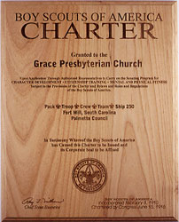
Genius of Charter Organization
What is a Charter Organization?
A community organization that enters into a working association with the Boy Scouts of America, adopting the program, and is chartered to operate traditional Scouting units.

Slide 5
Genius of Charter Organization
Overview of Charter Organizations
Civic, faith-based and educational organizations
Over 100,000 Scouting units
71.5% – faith-based
21.3% – civic
7.2% - educational

Slide 6
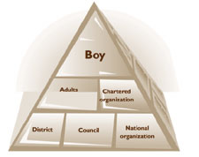
Genius of Charter Organization
Principal Responsibilities of CO:
Provide an adequate, safe meeting place
Providing quality leadership for the Scouting unit.
Adhere to policies and guidelines of the Boy Scouts of America.
Appoint a Chartered Organization Representative (COR)

Slide 7
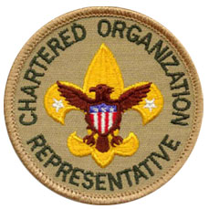
Genius of Charter Organization
Definition of a COR:
A person that coordinates all Scouting unit operations within the organization and serves as liaison between the unit, the organization, and the council structure.

Slide 8
Genius of Charter Organization
Responsibilities of a COR:
• Encourage unit leaders and committee members to take advantage of training opportunities and to regularly attend district roundtables.
• Promote well-planned unit programs.
• Organize units to serve the youth needs of your organization and its community.
• Promote the recruiting of new members.
• See that boys and adult volunteers graduate from one program phase to the next.
• Assist with annual unit charter renewal.
• Suggest unit Good Turns for your organization.
• Encourage unit committee meetings.
• Encourage the pursuit of JTE status
• Inform organization leaders.
• Encourage active outdoor unit programs.
• Emphasize advancement and recognition.
• Secure district help when needed.
• Use approved unit finance policies.
• Encourage recognition of leaders.
• Cultivate resources to support your organization’s units.
• Represent your organization on the council and district levels.

Slide 9
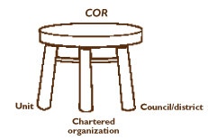
Genius of Charter Organization
The key person in the organization is the chartered organization representative, while the key person on the Scouting side of the relationship is the commissioner.
These two work together to guide and support unit leaders.

Slide 10
Genius of Charter Organization
How Can the Commissioner Help?
Meet with the Charter Organization Representative and Executive Officer regularly
Participate in the meeting with the XO to sign the Annual Charter Agreement
Personally train the Charter Organization Representative

Slide 11
Genius of Charter Organization
How Can the Commissioner Help?
Make sure the CO is involved in the selection of leaders
Encourage the COR to attend the District and Council Annual Meeting
Make sure the unit is requesting CO approval of finances and fund raising
Remind units of their need to conduct service project for their sponsor

Slide 12
Genius of Charter Organization
How Can the Commissioner Help?
Conduct yearly Charter Presentations
Public meeting of organization
Youth and Leaders present
Ensure sponsor is invited to every open event
Courts of Honor
Blue and Gold
Picnics

Slide 13
Genius of Charter Organization
How Can the Commissioner Help?
Recommend each unit present CO with an "Annual Report“
Assist with preparation of this report
Activities, successes, service, financial from previous year
Plans for upcoming year
Provides opportunity to request specific support from CO

Slide 14
Genius of Charter Organization
How Can the Commissioner Help?
Maintain open lines of communication that will head off potential problems or conflicts
“Sell” the COR on taking an active role in the Key 3 meetings of the unit.
Essential for the “new” unit assessments process and successful implementation of the Unit Service Plan

Slide 15
Genius of Charter Organization
Why:
When a charter organization is actively engaged with a scouting unit, both the unit and the organization thrive and are more successful.
Primary mission of a Unit Commissioner:
Help a unit succeed!

Slide 16
Genius of Charter Organization
Tools:
LHC Commissioner website: http://Commissioner-BSA.org/co

Slide 17
Questions?

Slide 18
Notes:
Thank You

